Slide 1


SD41 Burnaby
D.P.A.C.
District Parent Advisory Council
Confidential

Slide 2
MEET
THE EXECUTIVE TEAM
VIVIEN
GOMES-POLON
Chair
CJ
Liu
Vice Chair
Mike
Burton
SECRETARY
Treasurer
MEMBER AT LARGE
Courtney
Dicicco
MEMBER AT LARGE
Curtis
Moody
MEMBER AT LARGE
MEMBER AT LARGE
Confidential

Slide 3
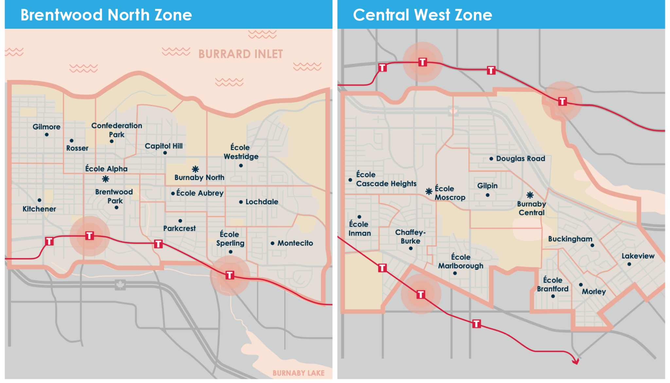
Zone 1 & 2
BRENTWOOD NORTH
1
CENTRAL WEST
2
Confidential

Slide 4
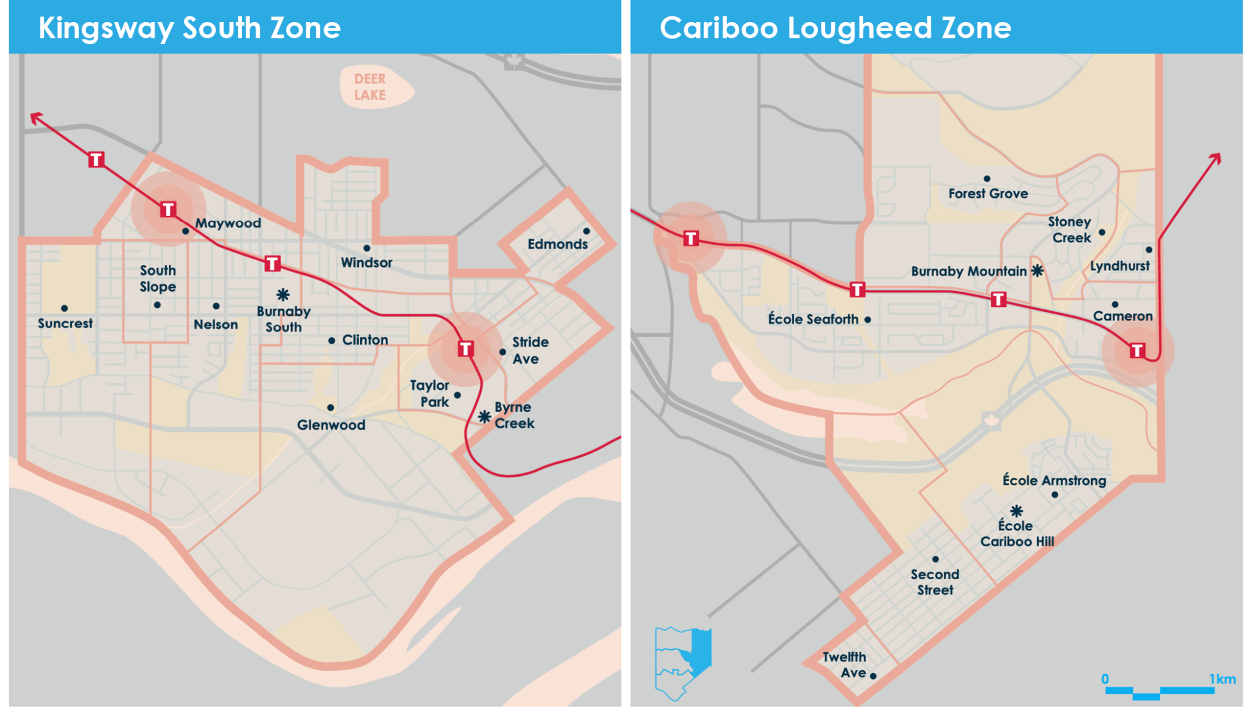
Zone 3&4
KINGSWAY SOUTH
3
CARIBOO LOUGHEED
4
Confidential

Slide 5


Education is the foundation of our future-shaping the leaders, innovators and citizens of tomorrow. Advocacy isn’t just raising issues. It’s about creating solutions together.
Confidential

Slide 6
Purpose of DPAC
“School act (province of BC) defines the responsibilities and authority of the DPAC as an advisory and advocacy council. It may make recommendations to the school board through the school board’s officials or by representation, and provide the school board with information to assist in decision-making.”
Source: SD41 Burnaby DPAC Constitution & Bylaw - Section II: Purpose of the DPAC

Slide 7
New Executive Goals
Top 3 priorities of DPAC 2026-2027
(forum, speakers, c&b, ..)
1
2
Governance - fairness, risk management, responsibility, transparency, accountability
3
Understand our roles as DPAC reps and
executives
4
Setting measurable goals, collaborate and working together, implement and evaluate
Confidential

Slide 8
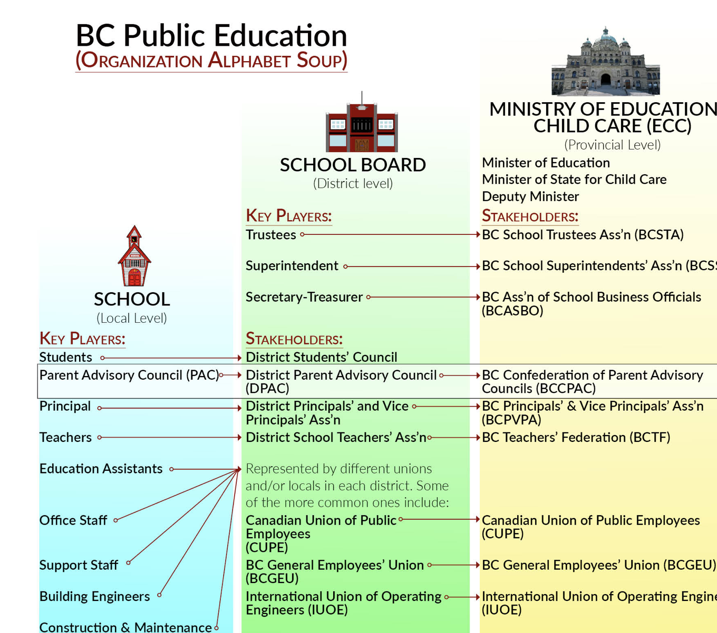
BCCPAC
CAMPAIGN OVERVIEW
Confidential

Slide 9
2026-2027
Action Plan
4
2
3
5
1
COMMITTEES
Selection process
(Attendance,
Reporting,
Advocating)
DATABASE MANAGEMENT
DPAC Reps
COLLABORATION
(trust, respect, communication)
* Inform PAC about committees
* collect feedbacks
COMMUNICATION
STRATEGY
*leadership manual
*website
*newsletter
The process of implementation
&
Evaluation
Confidential

Slide 10
Treasurer
report &
budget
2026-2027
CJ Liu
COMMITTEES & PUBLIC MEETINGS
*selection process
* ongoing committees
SOGI (Gaby, Maywood)
EDI (Vacant)
Sustainability (Kate, Brentwood)
DTAC (Morton, Brandford, Vasanth, Alpha)
DACC (Erfan, Edmonds)
Equity Scan (Trinity, Mountain)
Accessibility (Allison, Nelson)
DPAC committee: Constitution & Bylaw, Public Engagement, Website project
*Community of Whole (Chair)
*Burnaby Public Board (Chair)
*City of Burnaby - Transportation (Brock)

Slide 11
UPCOMING DATES
Oct 5 Mini PAC 101
Oct 19 Next General Meeting
Committee:
Sept 23 SOGI (Gaby)
Sept 24 Sustainability (Kate)
Sept 29 - Burnaby Board (next Nov. 24)
Oct 15 - EDI (vacant)
COW - 2nd Monday of Month (next. Jan. 11)
PAC/DPAC Reps / Committee / Community Partners News
*Queer Momentum - DPAC/Community volunteer needed
*For our kids network - national survey about temperature in classes

